Slide 1
Manchester
Raspberry
Jam XVII
January 2014

Slide 2
Last time…

Slide 3
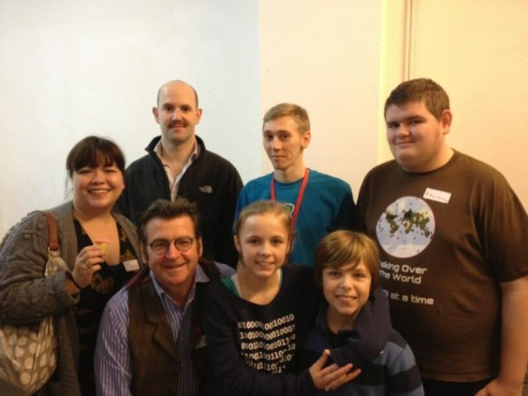
Raspberry Pi Foundation
at Manchester Raspberry Jam

Slide 4
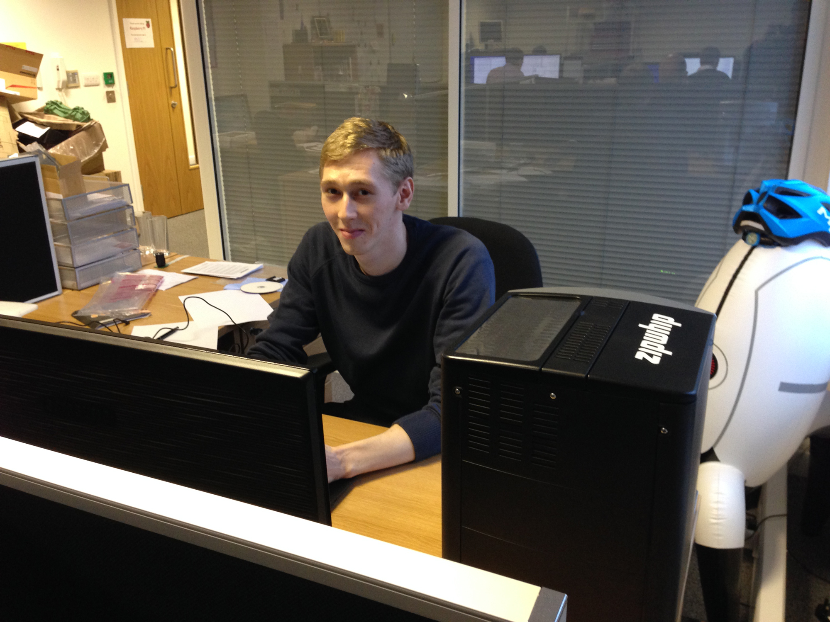
Ben moves to Cambridge
http://www.raspberrypi.org/archives/5349

Slide 5
No December Jam
Sorry about that...

Slide 6
In other news...

Slide 7
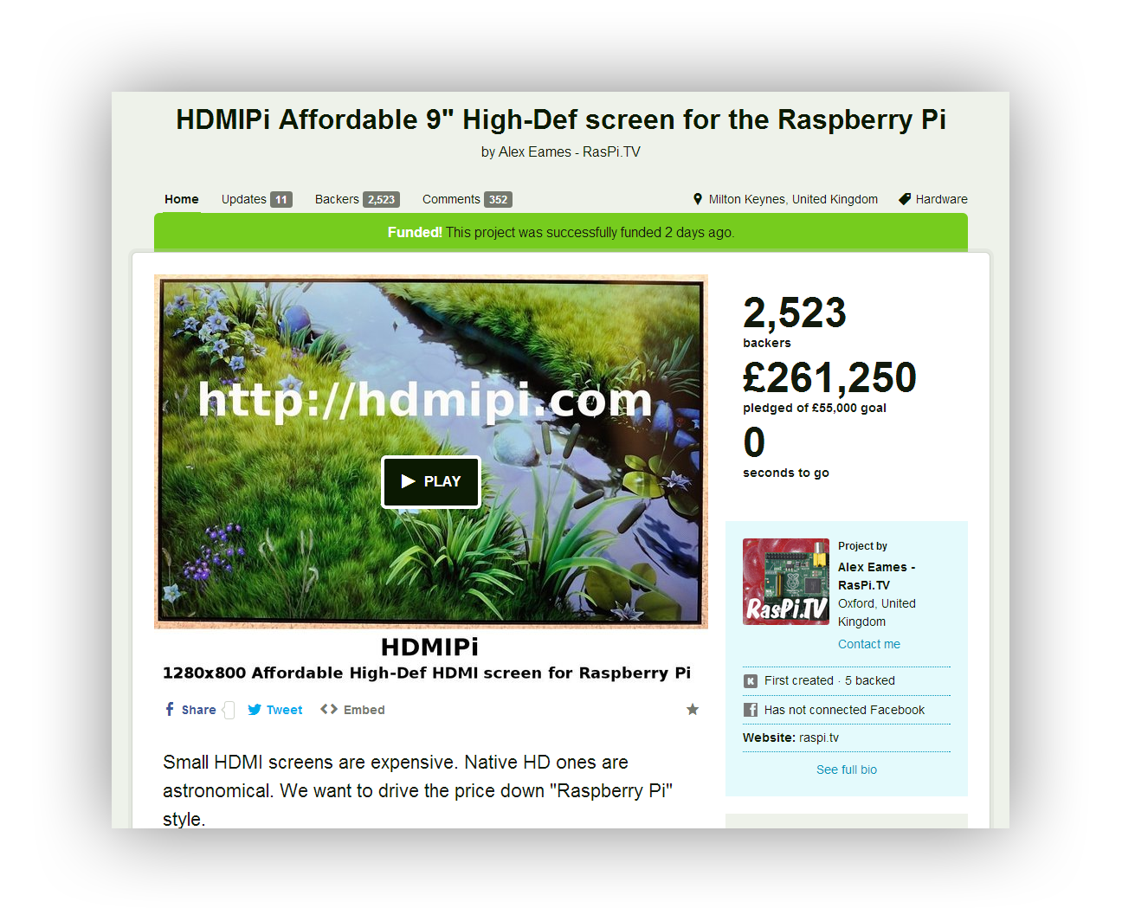
Kickstarter - HDMIPi
http://www.kickstarter.com/projects/697708033/hdmipi-affordable-9-high-def-screen-for-the-raspbe/posts/679140

Slide 8
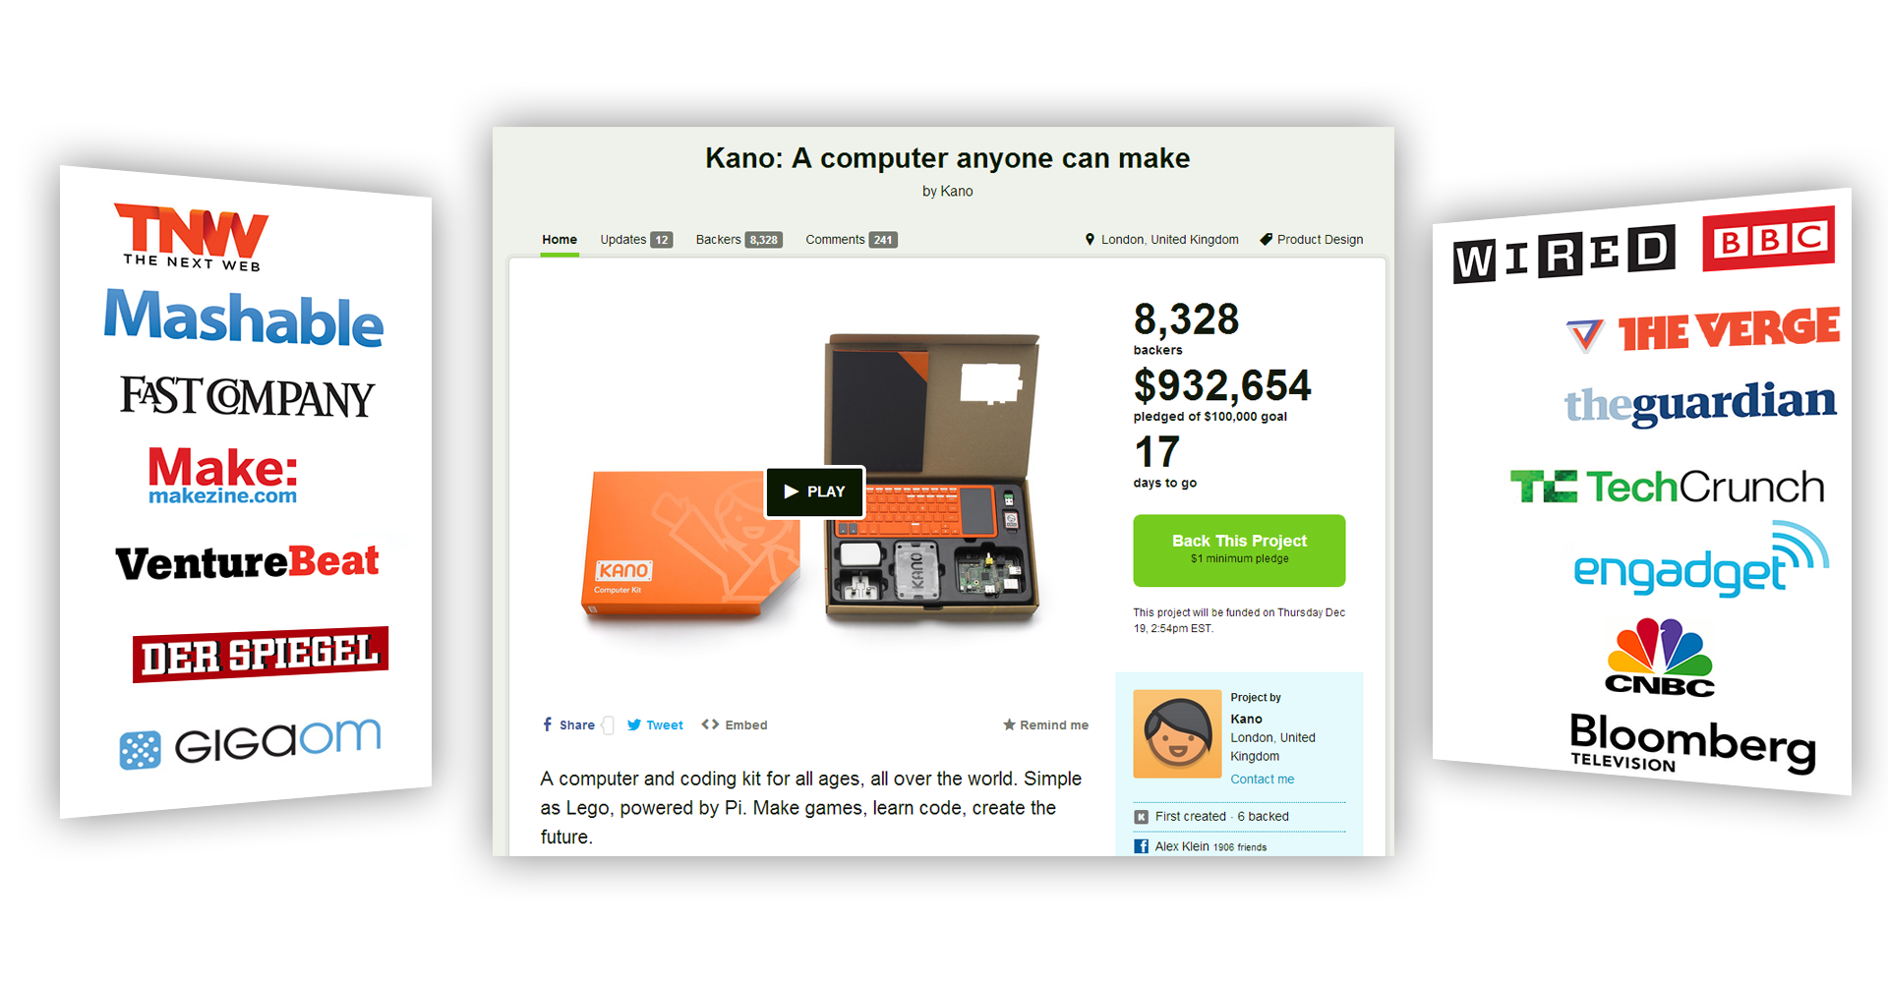
Kickstarter - Kano
Finished on $1,522,160
http://www.kickstarter.com/projects/alexklein/kano-a-computer-anyone-can-make

Slide 9
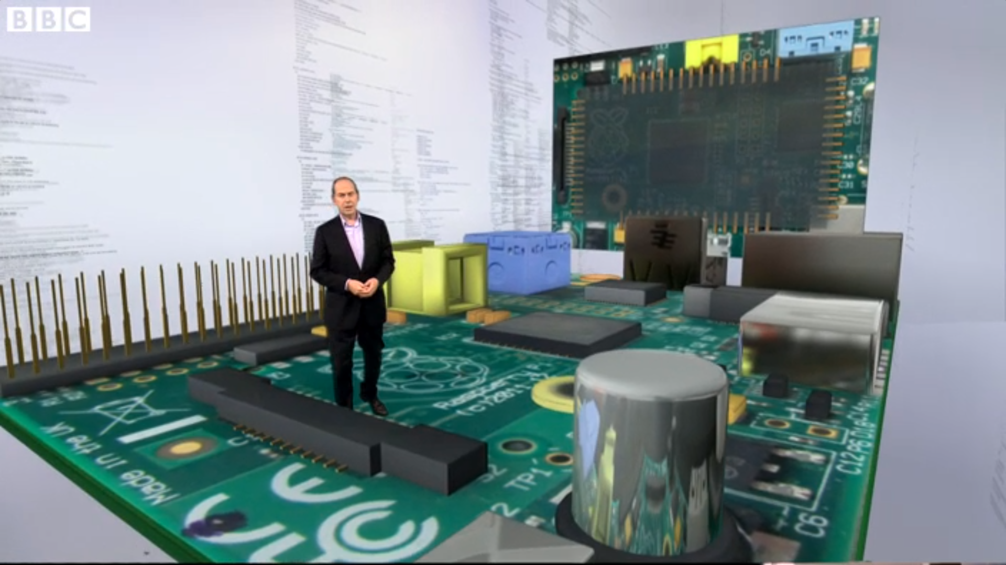
Computing at School
http://www.bbc.co.uk/news/technology-25851739

Slide 10
Projects...

Slide 11
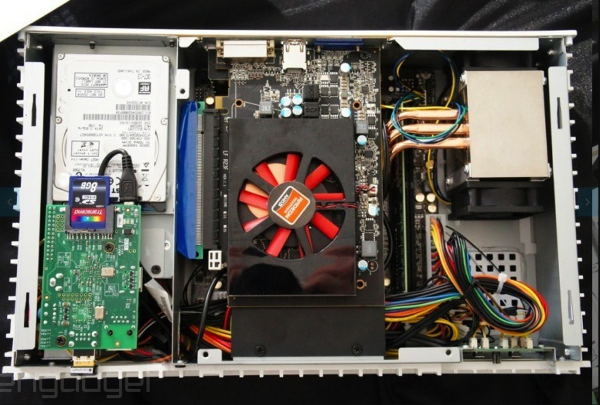
Raspberry Pi Steam Machine
http://www.raspberrypi.org/archives/5812

Slide 12
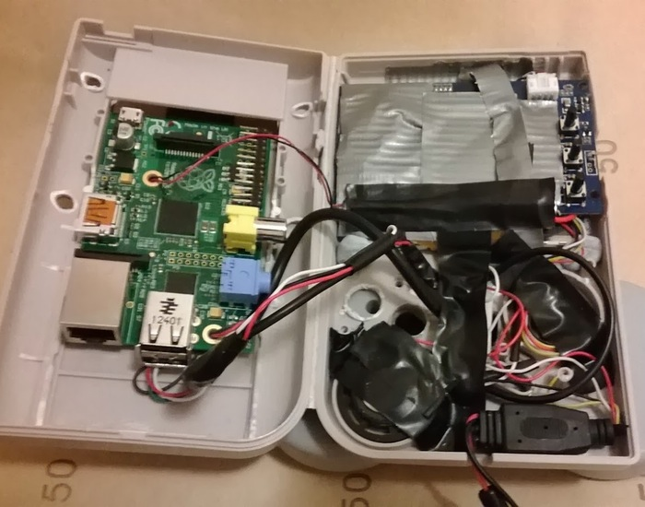
Pi-Boy
http://www.geeky-gadgets.com/pi-boy-combines-a-raspberry-pi-with-a-gameboy-console-video-21-01-2014/

Slide 13
For Today...

Slide 14
Normality has
been restored.
Pizza at 1pm
Everything’s
gone crazy

Slide 15
Thanks to
our Sponsors...

Slide 16
also our community sponsors:
Paul Waring
(@pwaring)
Simon Walters Dave Jones
Ann Howard Daniel Tibble

Slide 17

Next Months Jam
February the 15th
(The quiet jam)
be sure to
go to:

